Slide 1

Code Refactoring and Bug Fixing

Slide 2
Scenario:
A team of enthusiastic data scientists embarked on a mission to develop a Note Taking Application using Python, Flask, and HTML. However, their lack of experience in backend development has led to challenges in making the application fully functional. Recognizing your proficiency in backend development, you have been tasked with fixing the broken code and ensuring the application works seamlessly.
Task:
Refactor the existing codebase and ensure the proper functioning of the Note Taking Application. Document all identified bugs during the debugging process. Remember, the task is not about recreating the app from scratch. Your goal is to fix the already existing codebase and make the application work as intended.

Slide 3
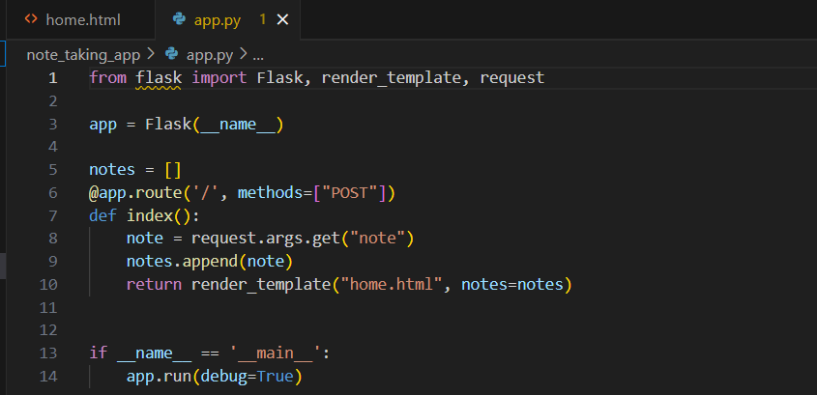
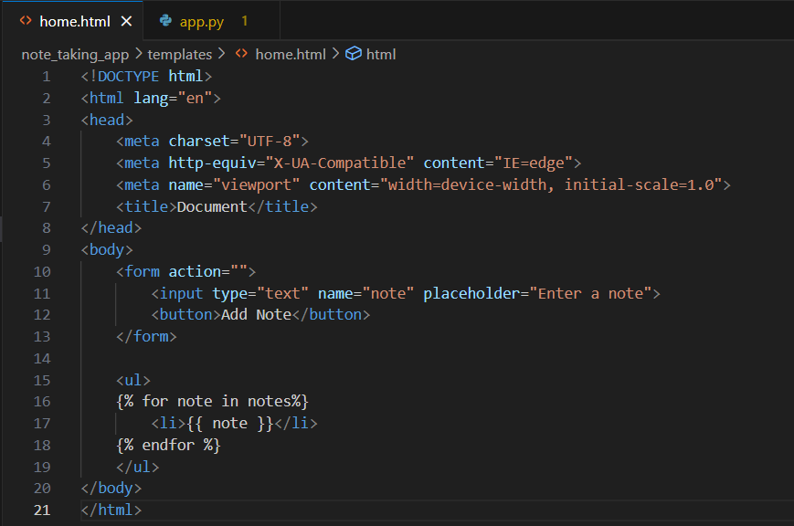
Identification of bugs in the initial code
These code snippets constitute the initial implementation of Flask application and the bugs present in them need to be identified and corrected.

Slide 4
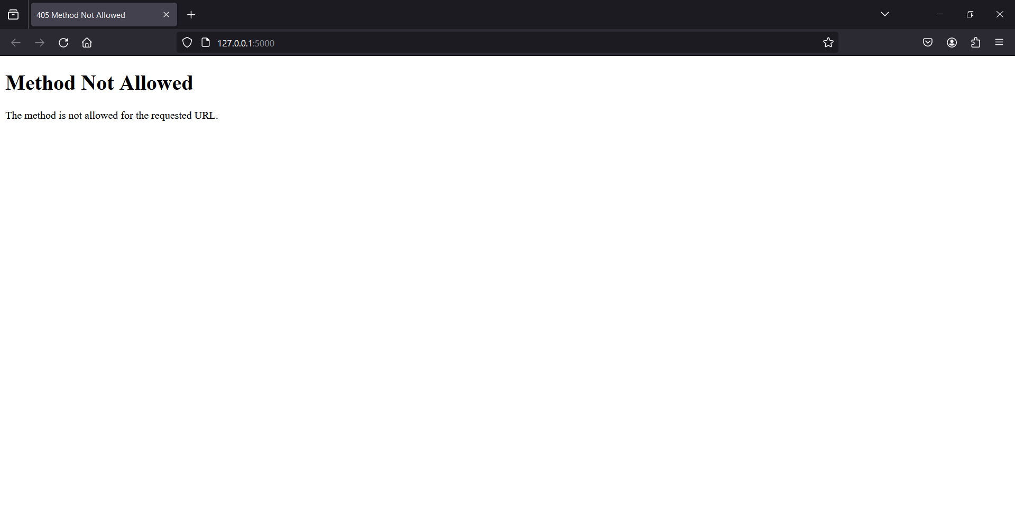

This is the initial screen that appears when the given code is implemented. This depicts that there is a client error.
Bug: In app.py code, the method in the route is set to POST only. It also require GET method, such that client can read and write data.
Bug fixing: Adding GET method

Slide 5
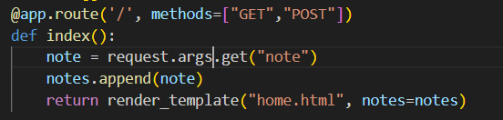
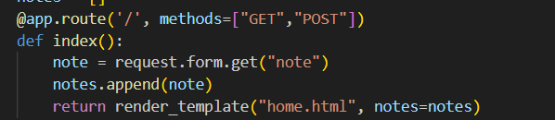
Previous code:
After fixing the previous bug, webpage opened
Bug: For this page, data need to sent as a part of the URL, typically in the form of key-value pairs. This is not a correct way to get data from the client.
Bug Fixing: Replace ‘args’ with ‘form’ in the following line of code.
Modified code:

Slide 6
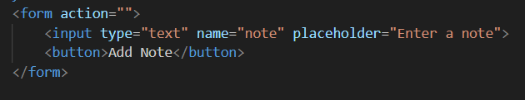
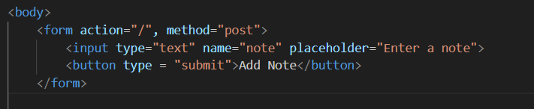
Previous code:
Bug: method for the form tag is not given.
Bug Fixing: Give “POST” as the attribute value for method
Bug: Type of the button is not mentioned
Bug Fixing: Mention the type of the button.(“Submit”)
Modified Code:

Slide 7
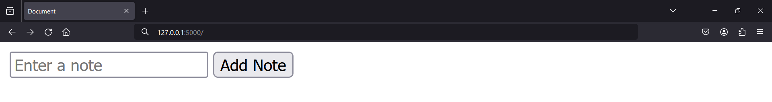
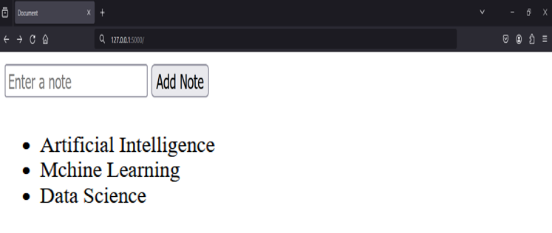
After fixing all the bugs, the application is working well.

Slide 8

THANK YOU

